Slide 1

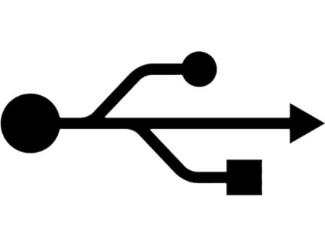
UNIVERSAL SERIAL BUS (USB)
By:
Shobhit Singh Ranawat
Section “A”, 3rd semester
Computer Science and Engineering
RVCE
(under the guidance of Prof. Anjan K)

Slide 2

Index
Slide Number
USB: Introduction 3
Need for USB 4
USB Architecture 8
Basic concepts & nomenclature 10
Addressing 13
USB Protocols 14
Output transfer 16
PID Types(USB 2.0) 18
Basic transfer types 19
Isochronous Traffic on USB 20
USB Features 23
USB Interfaces 25
USB 2.0 Pinout 26
USB 3.0 28
USB vs. FireWire 30

Slide 3
USB: An introduction
Universal Serial Bus (USB) is an industry standard developed through a collaborative effort of several computer and communication companies.
Some of these companies are Compaq, Hewlett-Packard, Intel, Lucent, Microsoft, Nortel Networks and Philips.
It defines the cables, connectors and communications protocols used in a bus for connection, communication and power supply between computers and electronic devices.
USB supports various data transfer speeds:
* USB 1.1 : 12 megabits/sec
* USB 2.0 : 480 Mbps
* USB 3.0 : 4,800 Mbps = 4.8 Gbps

Slide 4
Need for a USB
It provides a simple, low-cost and easy to use interconnection system that overcomes the difficulties due to the limited number of I/O ports available on a computer.
It accommodates a wide range of data transfer characteristics for I/O devices, including telephone and internet connections.
It enhances user convenience through a “plug-and-play” mode of operation.

Slide 5
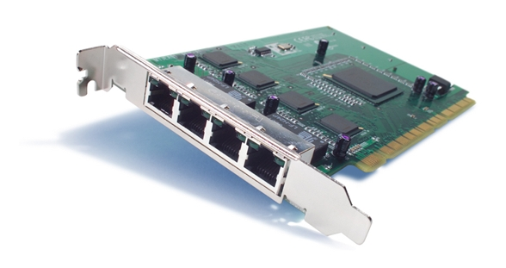
Port Limitation
In a typical computer, only a few parallel and series ports are provided as a general point of connection through which a variety of low-to medium-speed devices can be connected.
To add new ports, the user must open the computer box to gain access to the internal expansion bus and install a new interface card. The user must also need to know how to configure the device and the software.
A USB makes it possible to add many devices to a computer system at any time without opening the computer box.
Cisco PIX 64-Bit/66-MHz 4-Port Fast Ethernet Interface Card

Slide 6

Device Characteristics
The speed, volume and timing constraints associated with data transfers to and from the devices that may be connected to a computer having a wide range of functionality, vary significantly.
Types of data transfers:
  Asynchronous: The data whose generation is not synchronized to any other event in a computer system; examples: pressing a key on keyboard, computer mice and the controls and manipulators used with video games etc.
  Isochronous: A sequence of events is isochronous if the events occur regularly or at equal time intervals; examples: sound picking by a microphone(It produces an analog electrical signal which must be converted into a digital form before it can be handled by the computer which is accomplished by sampling the analog signal periodically).
  An important requirement in dealing with sampled voice or music is to maintain precise timing in the sampling and replay process. A high degree of jitter (variability in sample timing) is unacceptable.
  Thus, the data transfer mechanism between a computer and a music system must maintain consistent delays from one sample to the next otherwise complex buffering and retiming circuitry would be needed.

Slide 7
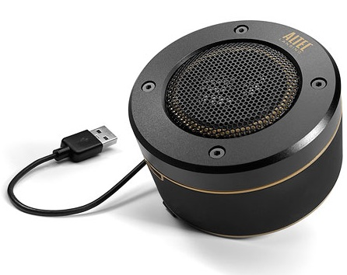
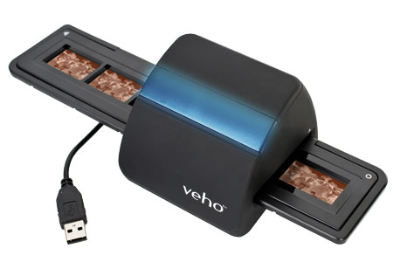
Plug-and-Play
The plug-and-play feature means that a new device (eg: speaker) can be connected at any time while the system is operating.
The system should detect the existence of this new device automatically, identify the appropriate device-driver software and any other facilities needed to service that device and establish the appropriate addresses and logical connections to enable them to communicate.
One of the primary objectives of the design of the USB has been to provide a plug-and-play capability.
Altec USB Speaker
Veho USB negative scanner

Slide 8
USB Architecture
To accommodate a large number of devices that can be added or removed at any time, the USB has the tree structure.
Each node of the tree has a device called a hub, which acts as an intermediate control point between the host and the I/O devices. At the root of the tree, a root hub connects the entire tree to the host computer. The leaves of the tree are the I/O devices being served (eg: keyboard, Internet connection, speaker, or digital TV)
In normal operation, a hub copies a message that it receives from its upstream connection to all its downstream ports. As a result, a message sent by the host computer is broadcast to all I/O devices, but only the addressed device will respond to that message.
However, a message from an I/O device is sent only upstream towards the root of the tree and is not seen by other devices. Hence, the USB enables the host to communicate with the I/O devices, but it does not enable these devices to communicate with each other.

Slide 9
USB Tree Structure
Host computer
Root
hub
Hub
Hub
Hub
de
I/O
I/O
I/O
I/O
vice
de
vice
de
vice
de
vice
de
I/O
I/O
vice
de
vice

Slide 10
Basic concepts and nomenclature
USB is a polled bus, meaning the host controller must initiate all transfers. This DOES NOT mean that the system software must poll the USB. The host controller takes care of polling the bus and can be programmed to issue interrupts to the OS whenever the bus needs attention.
USB System: A USB System consists of three discrete parts: the USB device(s), the USB interconnect, and the USB host.
  USB Devices: USB devices are classified as either a hub or a function. Hubs provide additional attachment points, whereas functions provide capabilities to the system. Functions are the I/O devices.
  USB Interconnect: The USB interconnect provides a connection from the USB device(s) to the USB host. Physically, the USB interconnect is a tiered star topology. A maximum of seven tiers are allowed, and the root hub occupies the first tier.
  USB Host: A USB system contains only one USB host. The host interfaces with the USB interconnect via a host controller. The host includes an embedded hub called the root hub which provides one or more attachment points, or ports.

Slide 11
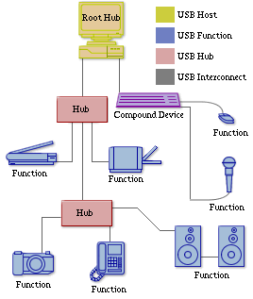
USB System Illustration

Slide 12
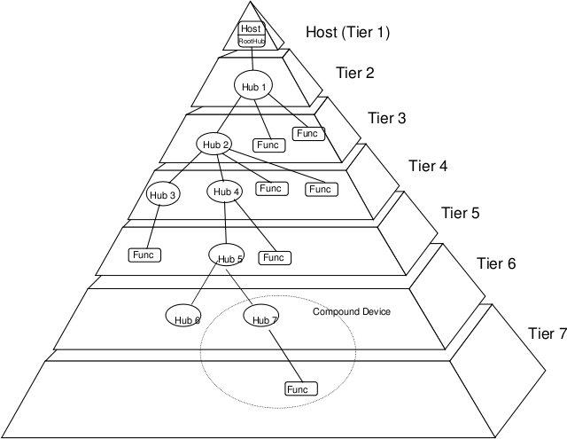
USB Topology
Some devices may implement several functions and an embedded hub in one physical package. These are called compound devices. Since compound devices contain an embedded hub, a compound device cannot be attached in tier 7.

Slide 13
Addressing
When a USB is connected to a host computer, its root hub is attached to the processor bus, where it appears as a single device.
The host software communicates with individual devices attached to the USB by sending packets of information, which the root hub forwards to the appropriate device in the USB tree.
Each device on the USB, whether it is a hub or an I/O device, is assigned a 7-bit address. This address is local to the USB tree and is not related in any way to the addresses used on the processor bus.
A hub may have any number of devices or other hubs connected to it, and addresses are assigned arbitrarily.
When a device is first connected to a hub, or when it is powered on, it has the address 0. The hardware of the hub to which this device is connected is capable of detecting that the device has been connected, and it records this fact as part of its own status information.
Periodically, the host polls each hub to collect status information and learn about new devices that may have been added or disconnected.
When the host is informed that a new device has been connected, it uses a sequence of commands to send a reset signal on the corresponding hub port, read information from the device about its capabilities, send configuration information to the device, and assign the device a unique USB address. Once this sequence is completed the device begins normal operation and responds only to the new address.

Slide 14
USB Protocols
All information transferred over the USB is organized in packets, where a packet consists of one or more bytes of information. There are many types of packets that perform a variety of control functions.
The information transferred on the USB can be divided into two broad categories: control and data.
  Control packets perform such tasks as addressing a device to initiate data transfer, acknowledging that data has been received correctly, or indicating an error.
  Data packets carry information that is delivered to a device.
A packet consists of one or more fields containing different kinds of information. The first field of any packet is called the packet identifier, PID, which identifies the type of that packet.
PIDs are transmitted twice. The first time they are sent with their true values, and the second time with each bit complemented.
The four PID bits identify one of 16 different packet types. Some control packets, such as ACK (Acknowledge), consist only of the PID byte.

Slide 15
PID₀ | PID₁ | PID₂ | PID₃ | PID₀ | PID₁ | PID₂ | PID₃
(a) Packet identifier field
Control packets used for controlling data transfer operations are called token packets.
Bits
8
7
4
5
PID
ADDR
ENDP
CRC16
(b) Token packet, IN or OUT
PID: Packet Identifier
CRC: Cyclic Redundancy Check
(The CRC bits are computed based on the contents of address (ADDR) and endpoint (ENDP) fields.)
Bits
8
0 to 8192
16
PID
D
A
T
A
CRC16
(c) Data packet
CRC protects all non-PID fields in token and data packets from errors during transmission.

Slide 16
Output Transfer
The host computer sends a token packet of type OUT to the hub, followed by a data packet containing the output data.
The PID field of the data packet identifies it as data packet number 0.
The hub verifies that the transmission has been error free by checking the error control bits, then sends an acknowledgement packet(ACK) back to the host.
The hub forwards the token and data packets downstream where all I/O devices receive it but only the device that recognizes its address in the token packet accepts the data in the packet that follows. After verifying that transmission has been error free, it sends an ACK packet to the hub.
Input operations follow a similar procedure. The host sends a token packet of type IN containing the device address. In effect, this packet is a poll asking the device to send an input data it may have. The device responds by sending a data packet followed by an ACK. If it has no data ready, it responds by sending a negative acknowledgement (NAK) instead.

Slide 17
Host
Hub
I/O De
evice
T
ok
en
Data0
A
CK
Time
T
ok
en
Data0
A
CK
An output transfer
T
ok
en
Data1
A
CK
T
ok
en
Data1
A
CK

Slide 18
PID Type | PID Name | PID [3:0] | Description
Token | OUT | 0001b | The packet describes a host-to-function transaction.
 | IN | 1001b | The packet describes a function-to-host transaction.
 | SOF | 0101b | The packet marks the start of frame and specifies the frame number.
 | SETUP | 1101b | Packet describes a SETUP transaction from the host to the function via a control pipe.
Data | DATA0 | 0011b | This packet is an even data packet.
 | DATA1 | 1011b | This packet is an odd data packet
 | DATA2 | 0111b | This packet is only used in high-speed, high-bandwidth isochronous transfers.
 | MDATA | 1111b | This packet is only used in split transactions, or high-speed, high-bandwidth isochronous transfers.
Handshake | ACK | 0010b | This packet acknowledges the successful receipt of a data packet.
 | NAK | 1010b | This packet indicates that data is not ready to be transmitted yet.
 | STALL | 1110b | This packet indicates that the endpoint has halted, or a control pipe does not support a certain request.
 | NYET | 0110b | The receiver has not yet responded, or the host should begin sending PING packets.
Special | PRE | 1100b | This packet is a host-issued preamble for a split-transaction.
 | ERR | 1100b | This packet is a handshake response that a split transaction error occurred. Note that this PID is identical to the PID for a PRE packet.
 | SPLIT | 1000b | This packet supports split transactions between the host and a high-speed hub.
 | PING | 0100b | This packet is used for flow-control in high-speed control and bulk transfers.
 | Reserved | 0000b | This is a reserved PID and must not be used.
PID Types (in USB 2.0)

Slide 19
4 Basic Transfer Types:
Control Transfers provide lossless transmissions and are used to configure a device. Thus, all USB devices must support control transfers at least via the default control pipe.
Bulk Data Transfers provide lossless, sequential transmissions and are typically used to transfer large amounts of data.
Interrupt Data Transfers provide reliable, limited-latency transmissions typically needed by human input devices such as a mouse or a joystick.
Isochronous Data Transfers, also called Streaming Real-time Transfers, negotiate a required bandwidth and latency when initializing the transfer. This transfer type is predominantly used for such applications as streaming audio. Since data-delivery rate is considered more important than data integrity for this type of transfer, it does not provide any type of error checking or correction mechanism.

Slide 20
Isochronous Traffic on USB
One of the key objectives of the USB is to support the transfer of isochronous data (such as sampled voice).
Devices that generates or receives isochronous data require a time reference to control the sampling process.
To provide this reference, transmission over the USB is divided into frames of equal length.
A frame is 1ms long for low-and full-speed data.
The root hub generates a Start of Frame control packet (SOF) precisely once every 1 ms to mark the beginning of a new frame.
The arrival of an SOF packet at any device constitutes a regular clock signal that the device can use for its own purposes.
To assist devices that may need longer periods of time, the SOF packet carries an 11-bit frame number.
Following each SOF packet, the host carries out input and output transfers for isochronous devices.
This means that each device will have an opportunity for an input or output transfer once every 1 ms.

Slide 21
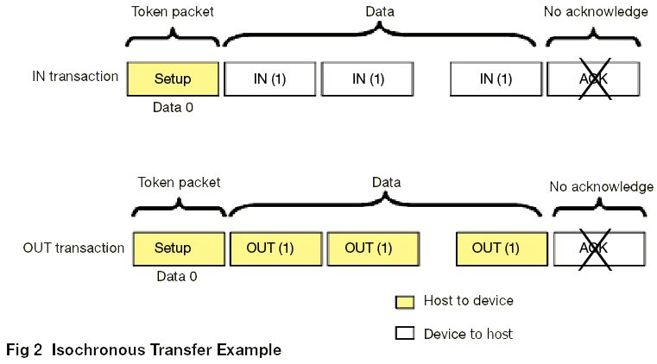
For high speed and full speed devices, the polling is done by using (IN/OUT) token packets. When the endpoint is ready to send data, the device responds to one of the IN token packets by sending data. To write to the device, the host controller sends an OUT token packet followed by data packets. The host controller or device does not send any handshake packets, and therefore, there is no guaranteed delivery. Because the host controller does not attempt to retry the transfer, data might be lost if an error occurs.
Isochronous Traffic on USB
Isochronous transfers are meant for devices where data transmission rate is more important than data integrity. For that reason, isochronous transfers do not allow handshakes and thus cannot stall.

Slide 22
Note:
Isochronous data transfer ensures that data flows at a pre-set rate so that an application can handle it in a timed way. For multimedia applications, this kind of data transfer reduces the need for buffering and helps ensure a continuous presentation for the viewer.
To manage the reserved time for isochronous endpoints, the time is divided into consecutive logical chucks, called bus intervals. The unit of bus interval depends on the bus speed.
Isochronous transfers are packet based. The term isochronous packet in this topic refers to the amount of data that is transferred in one bus interval.
The characteristics of the endpoint determine that the size of each packet is fixed which is determined by the characteristics of the endpoint.

Slide 23
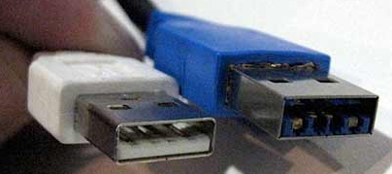
USB Features (1 of 2)
Easy to use for end user
  Single model for cabling and connectors
  Electrical details isolated from end user (e.g., bus terminations)
  Self-identifying peripherals, automatic mapping of function to driver, and configuration
  Dynamically attachable and re-configurable peripherals
Wide range of workloads and applications
  Suitable for device bandwidths ranging from a few kb/s to several Mb/s
  Supports isochronous as well as asynchronous transfer types over the same set of wires
  Supports concurrent operation of many devices (multiple connections)
  Supports up to 127 physical devices
  Supports transfer of multiple data and message streams between the host and devices
  Allows compound devices (i.e., peripherals composed of many functions)
  Lower protocol overhead, resulting in high bus utilization
Isochronous bandwidth
  Guaranteed bandwidth and low latencies appropriate for telephony, audio, etc.
  Isochronous workload may use entire bus bandwidth
Flexibility
  Supports a wide range of packet sizes, which allows a range of device buffering options
  Allows a wide range of device data rates by accommodating packet buffer size and latencies
  Flow control for buffer handling is built into the protocol

Slide 24
USB Features (2 of 2)
Robustness
  Error handling/fault recovery mechanism is built into the protocol
  Dynamic insertion and removal of devices is identified in user-perceived real-time
  Supports identification of faulty devices
Relation with PC industry
  Protocol is simple to implement and integrate
  Consistent with the PC plug-and-play architecture
  Leverages existing operating system interfaces
Low-cost implementation
  Low-cost sub-channel at 1.5Mb/s
  Optimized for integration in peripheral and host hardware
  Suitable for development of low-cost peripherals
  Low-cost cables and connectors
  Uses commodity technologies
Upgrade path
  Architecture upgradeable to support multiple USB Host Controllers in a system

Slide 25
USB Interfaces
USB 1.0 (obsolete)
released in 1996.
Specifies data rates of 1.5 Mbit/s (Low-Bandwidth, is mostly used for Human Input Devices (HID) such as keyboards, mouses, joysticks and often the buttons on higher speed devices such as printers or scanners) and 12 Mbit/s (Full-Bandwidth).
USB 2.0
released in 2000
in addition to USB 1.0 adds signaling rate of 480 Mbit/s (Hi-Speed)
compatible with USB 1.0, but some hardware designed for USB 2.0 may not work with USB 1.0 host controllers.
USB 3.0
released in 2008
added transmission rates up to 5 Gbit/s (SuperSpeed)

Slide 26

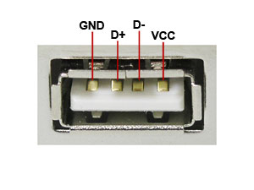
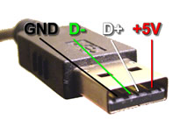
USB 2.0 Pinout
PIN | NAME | CABLE COLOR | DESCRIPTION
1 | Vcc | Red | +5 Vdc
2 | D- | White | Data -
3 | D+ | Green | Data +
4 | GND | Black | Ground
USB is a serial bus. It uses 4 shielded wires: two for power (+5V & GND) and two for differential data signals (labeled as D+ and D- in pinout).

Slide 27
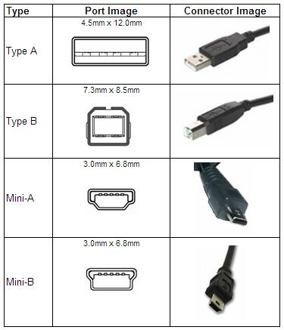
There are 4 types of USB 2.0 ports and connectors:

Slide 28


USB 3.0
USB 3.0, also known as the SuperSpeed bus, was designed to address the limitation of slow transfer rate.
USB 3.0 introduces a fourth transfer mode of 5Gbps (gigabits per second). This new transfer mode upgrades the USB technology to support a maximum throughput of about 600MB/s while still maintaining backwards compatibility with the older signaling rates.
This allows a USB 3.0 mass storage device to be connected onto a legacy USB 2.0/1.1 port, and likewise. There are two types of connector and plug combinations in USB 3.0 specification, SuperSpeed standard A and SuperSpeed standard B.
USB Signaling Rate Chart
Low Speed | USB 1.0 | 1.5 Mbps
Full Speed | USB 1.1 | 12 Mbps
Hi-Speed | USB 2.0 | 480 Mbps
SuperSpeed | USB 3.0 | 5 Gbps
SuperSpeed standard A plugs will fit legacy A receptacles but SuperSpeed standard B plugs will not fit into legacy standard B receptacles.

Slide 29
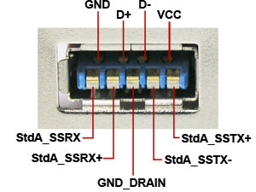
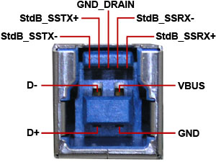
SuperSpeed standard A plug pinout
SuperSpeed standard B plug pinout
1 | VBUS | Red
2 | D- | White
3 | D+ | Green
4 | GND | Black
5 | StdA_SSRX- | Blue
6 | StdA_SSRX+ | Yellow
7 | GND_DRAIN | GROUND
8 | StdA_SSTX- | Purple
9 | StdA_SSTX+ | Orange
Shell | Shield | Connector Shell
1 | VBUS | Red
2 | D- | White
3 | D+ | Green
4 | GND | Black
5 | StdA_SSTX- | Blue
6 | StdA_SSTX+ | Yellow
7 | GND_DRAIN | GROUND
8 | StdA_SSRX- | Purple
9 | StdA_SSRX+ | Orange
Shell | Shield | Connector Shell

Slide 30

USB vs. IEEE 1394 (FireWire)
USB | FireWire
1. USB networks use a tiered-star topology. | 1. IEEE 1394 networks use a tree topology.
2. USB 1.0, 1.1 and 2.0 use a "speak-when-spoken-to" protocol; peripherals cannot communicate with the host unless the host specifically requests communication USB 3.0 allows for device-initiated communications towards the host. | 2. A FireWire device can communicate with any other node at any time, subject to network conditions.
3. A USB network relies on a single host at the top of the tree to control the network. | 3. In a FireWire network, any capable node can control the network.
4. USB runs with a 5V power line. | 4. FireWire in current implementations supplies 12V and theoretically can supply up to 30V.
5. USB was designed for simplicity and low cost. | 5. FireWire was designed for high performance.

Slide 31
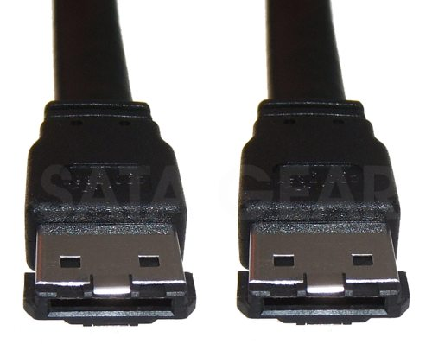
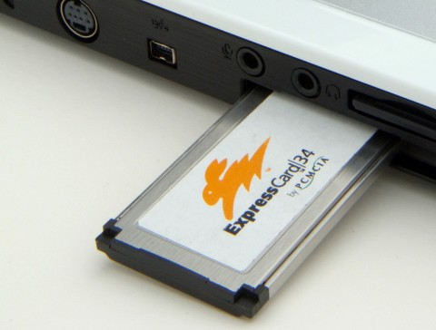
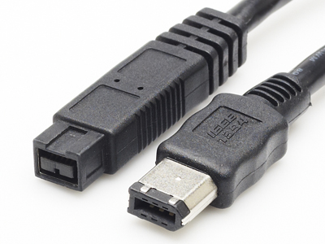
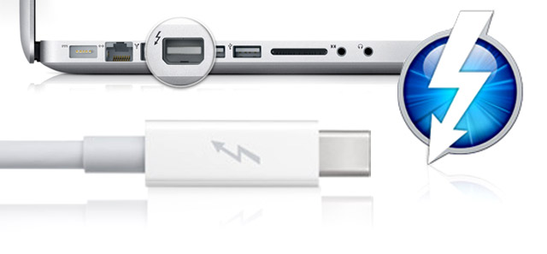
Other available ports and connectors
eSATA
Express Card
Thunderbolt
FireWire

